Slide 1
“We’re not preparing students for Jeopardy anymore… it’s a thinking game now!”
The PBL Project
Session 3
Thinking Exercises

Slide 2
Just to recap, what is
Problem-Based Learning?

Slide 3
The Recap:
Problem Solving is a 3 Step Process
When presented with any situation
(or problem, or challenge), students must be able to
Step 1
Gather and
absorb
the information
(“stimulus”)
Step 2
Filter
through the
information
(“evidence”)
Step 3
Generate
different
types of
“responses”

Slide 4
“The skills of Problem-Based Learning will be used
over and over… and over again.

Slide 5
How do students become good Problem-Solvers?

Slide 6
“Things aren’t always as simple as they seem.”
For example:
The goal of basketball is to put the ball through the hoop:
…but before you can do that, you must practice other skills.

Slide 7
The Metaphor:
To be a good basketball player, you must practice:
To be a good problem-solver, you must practice:
Passing
Dribbling
Defense
Critical Thinking
Creativity
Filtering Information

Slide 8
“Get ready for PBL Training Camp”
Students must learn what is being asked of them, and in what manner they should respond.
We will practice this using Critical Thinking Exercises
Students must learn how to approach scenarios in different ways.
We will practice this using Creativity Drills
Students must learn what information must be obtained before they can properly respond to a scenario.
We will practice this using Woodchuck Problems

Slide 9
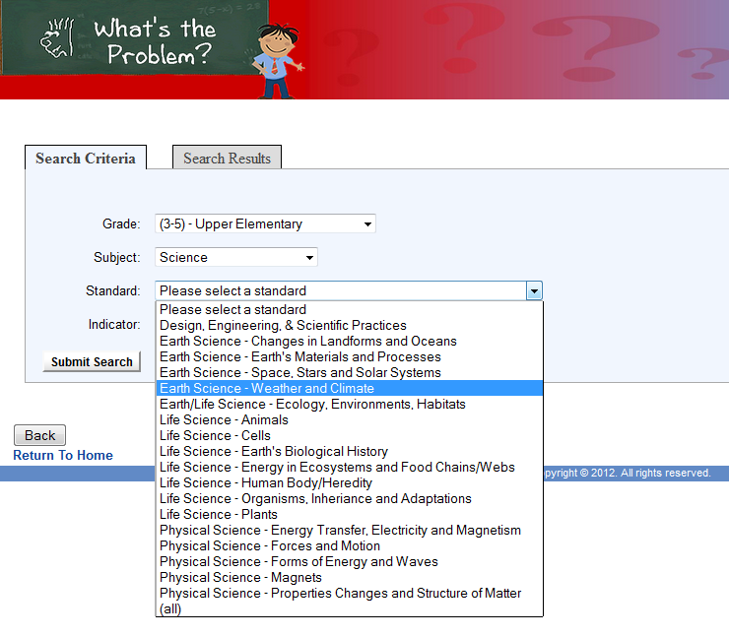
“Let the coaching begin!”
Hundreds of exercises are available within the PBL Project

Slide 10
Can we go over the “drills” again?
Critical Thinking Exercises
Creativity Drills
“Woodchuck” Problems

Slide 11
Critical Thinking Exercises
“What is being asked, and what is expected from me?”
Includes:
Forced Choice
Abstract Questions
“What Would Happen If..” Scenarios

Slide 12
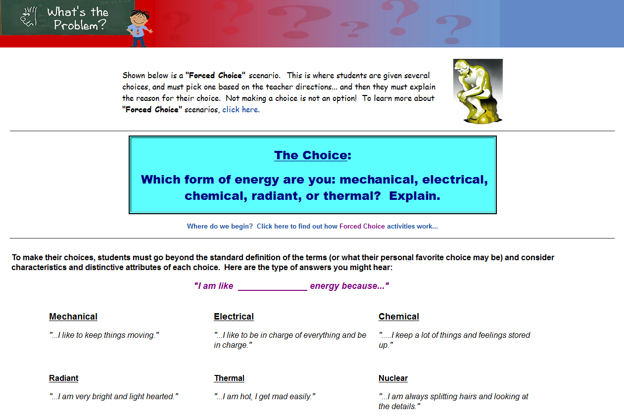
Sample Critical Thinking Exercise:
Forced Choice
students must make an abstract choice based on the characteristics of objects

Slide 13
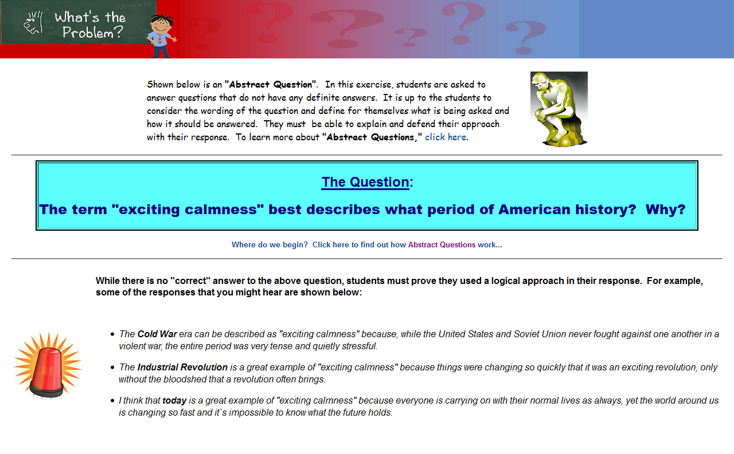
Sample Critical Thinking Exercise:
Abstract Questions
students are asked to answer questions that have no definite answer

Slide 14
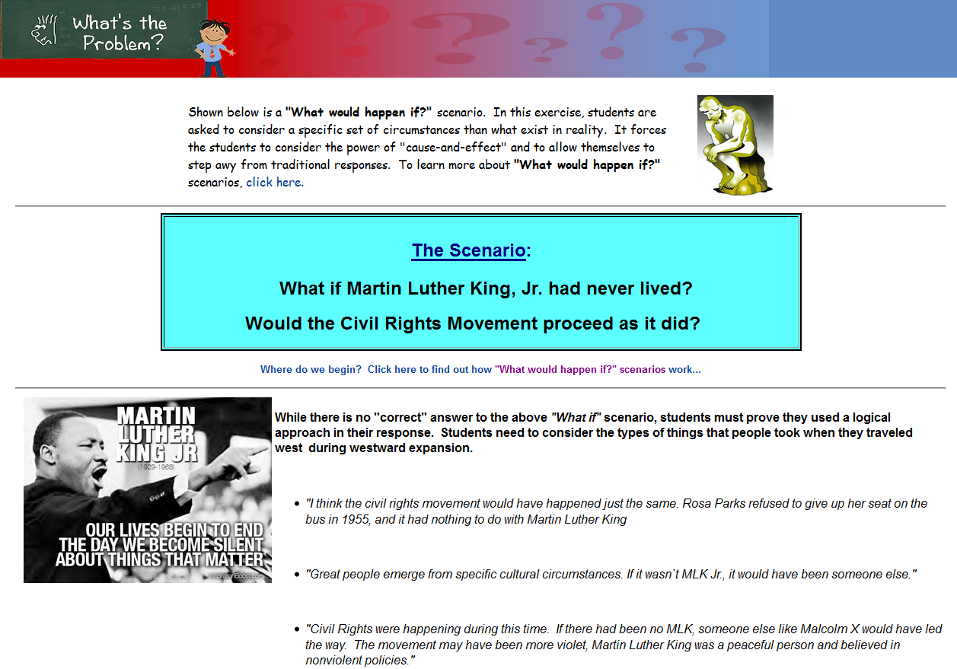
Sample Critical Thinking Exercise:
“What Would Happen If…?”
students are asked to consider a specific set of circumstances other than what exists in reality

Slide 15
Creativity Drills
“What are different ways to approach this problem?
Includes:
“In Your Own Words”
How Many?
SCAMPER Activities

Slide 16
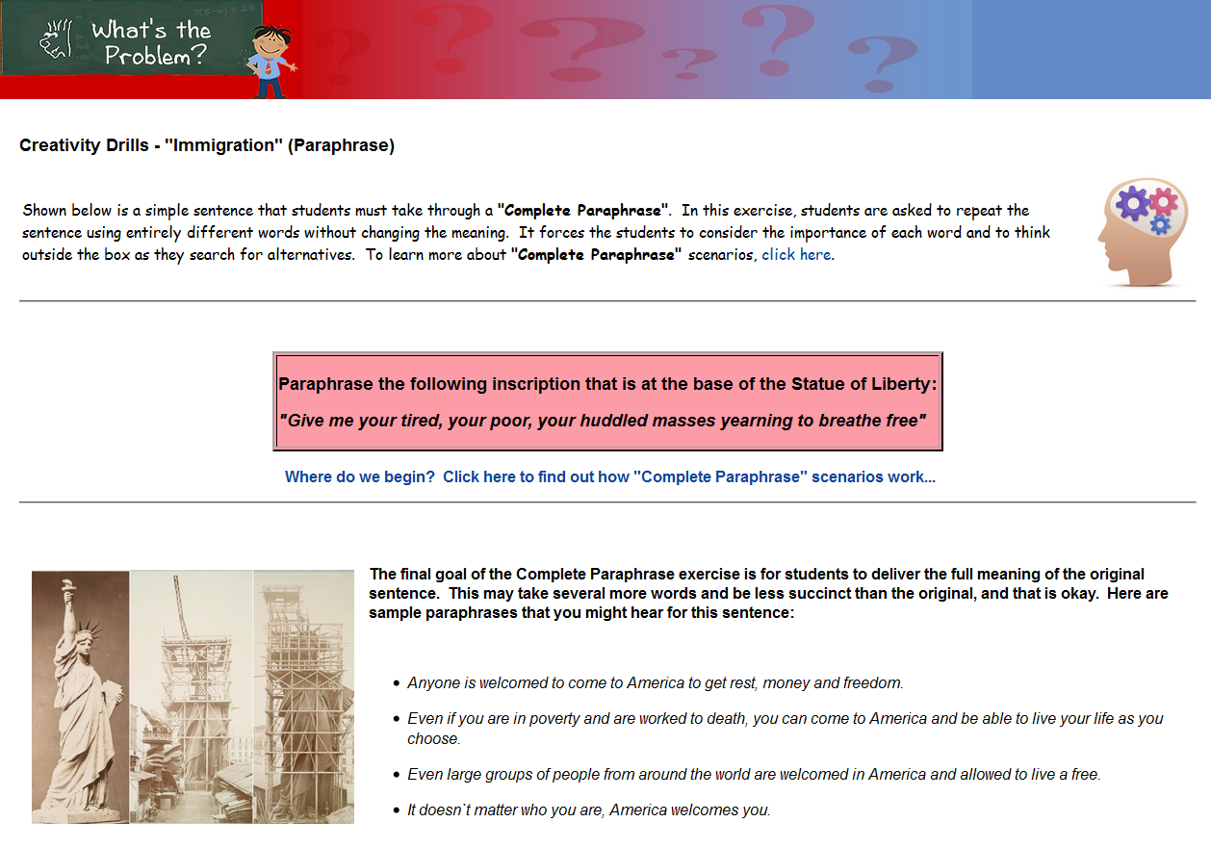
Sample Creativity Drills:
“In Your Own Words”
students must re-state a simple statement using new wording

Slide 17
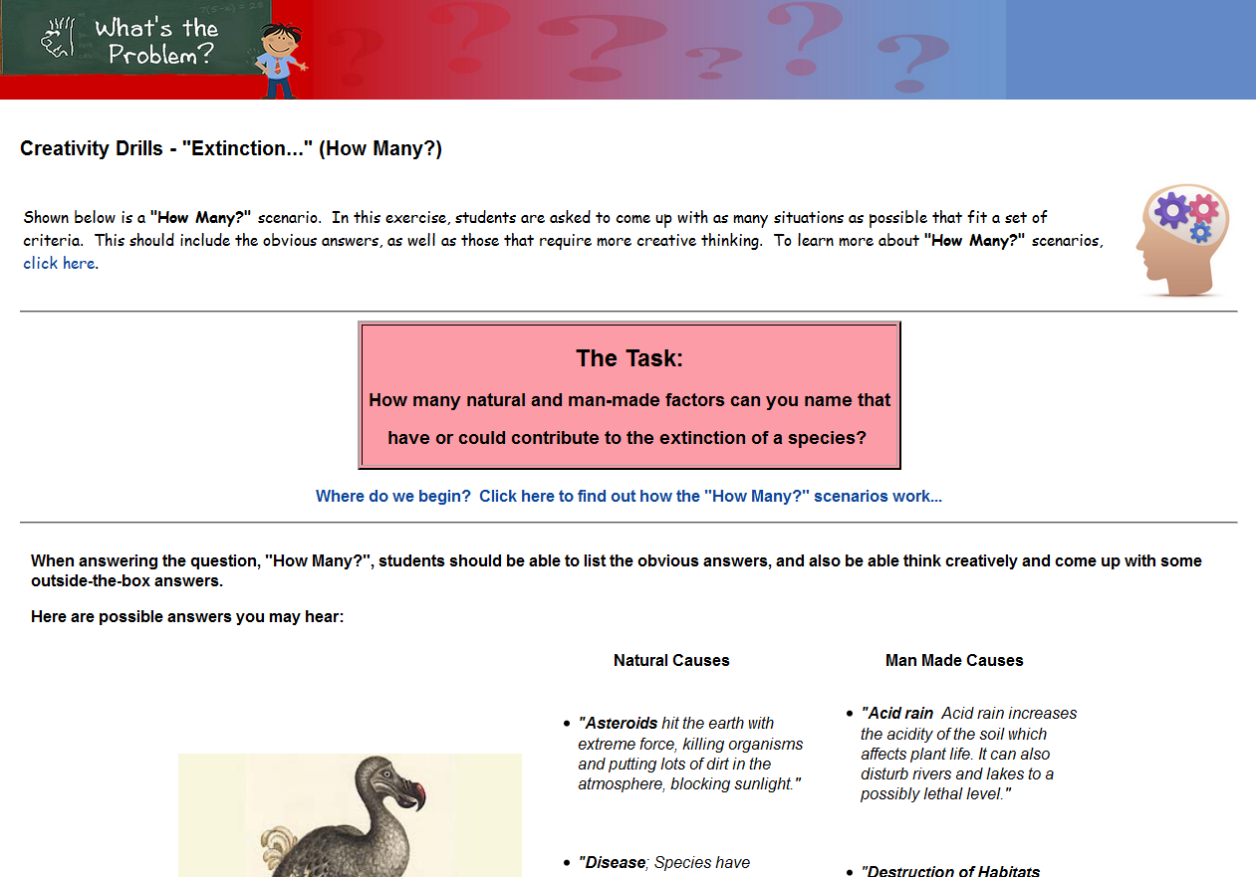
Sample Creativity Drills:
“How Many?”
students are asked to come up with as many scenarios as possible that fit a set of criteria

Slide 18
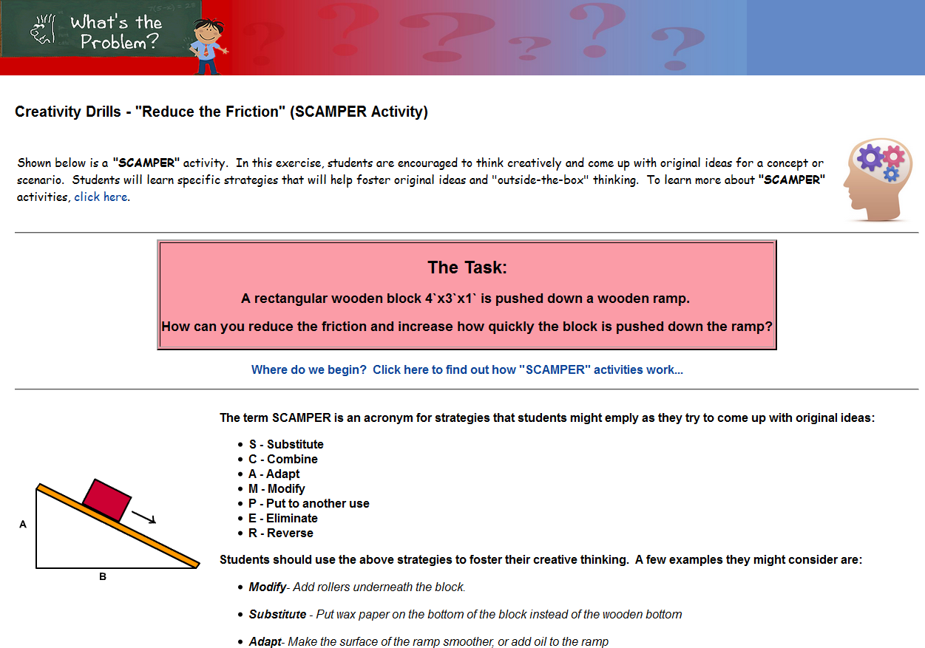
Sample Creativity Drills:
SCAMPER
(Substitute, Combine, Adapt, Modify, Put to another use, Eliminate, Reverse)
students must think creatively to come up with original ideas for a concept

Slide 19
“Woodchuck” Problems
What information do I need to provide a suitable answer?
Woodchuck Problems are scenarios that require students to ask questions and seek more information before they can properly answer it.

Slide 20
Where did the name “Woodchuck” come from?
These are named for the most famous “Woodchuck” Problem of all:
How much wood could a woodchuck chuck if a woodchuck could chuck wood?
You could answer this if you knew:
How big are the woodchuck’s teeth?
How long is will it be chucking the wood?
What exactly is “chucking”?
BUT FIRST YOU HAVE TO FIND ALL OF THAT INFORMATION!

Slide 21
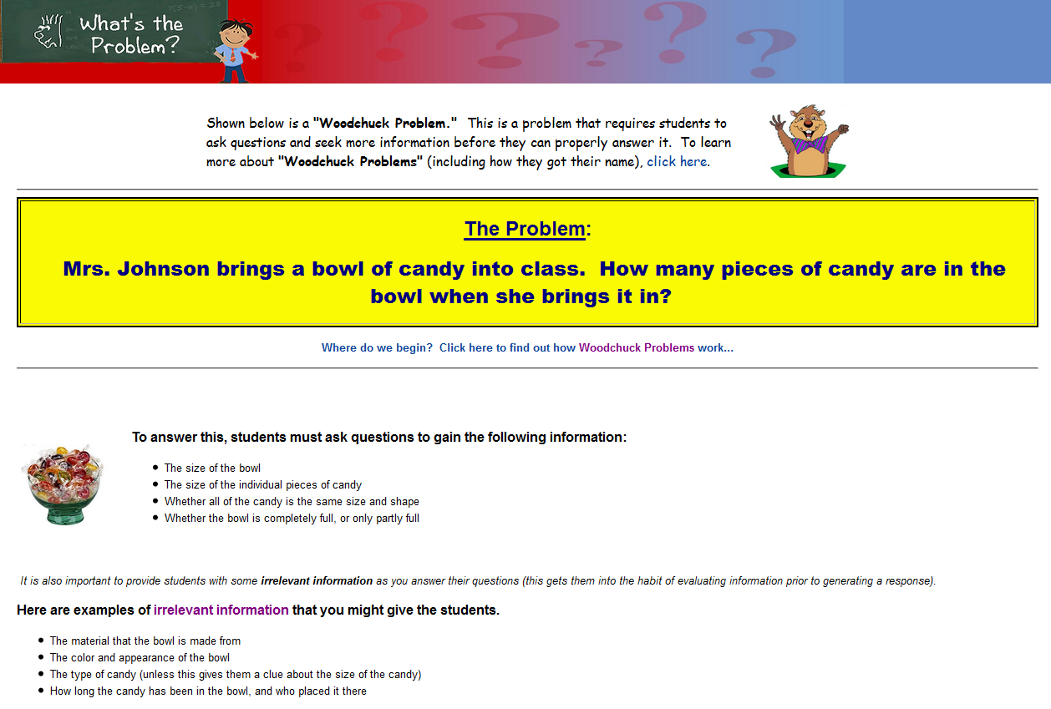
Sample “Woodchuck” Problems:
Woodchuck Problem
these are problems where students need to ask questions and seek out more information before they can provide a logical answer

Slide 22
Okay, we know that all of these exercises help build a foundation for Problem-Based Learning.
Anything else?

Slide 23
Yes… the PBL skills are only half of it.
With exercises for all standards, they also help students learn specific content.

Slide 24
“We’ve covered it all!”
The search menus make it easy to incorporate the exercises into your lessons.

Slide 25
How do I get to all of this great content?

Slide 26
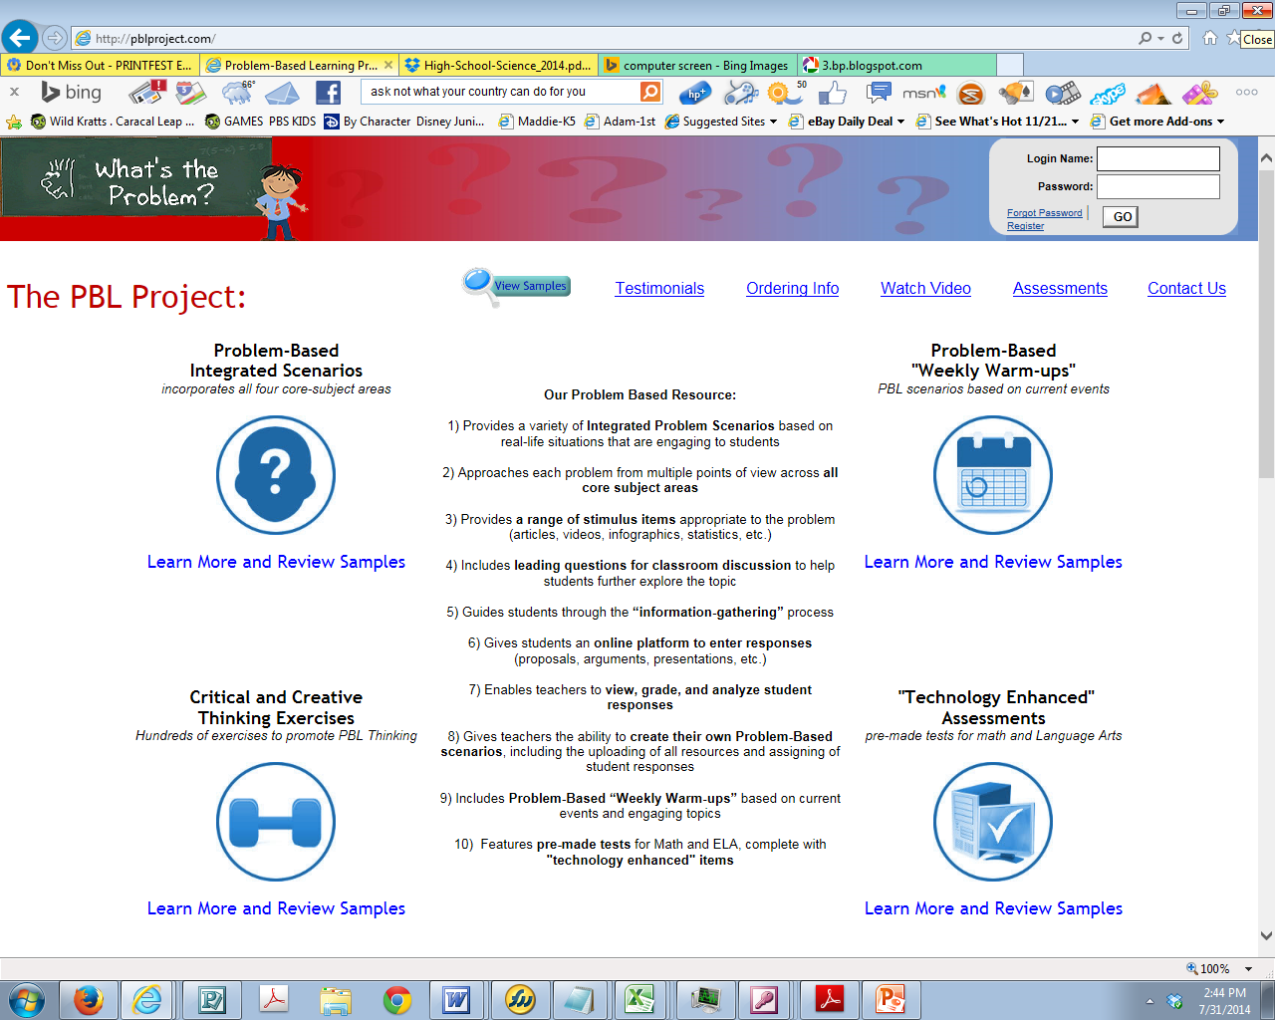
www.pblproject.com

Slide 27
www.pblproject.com
Remember, most teachers have the following login:
Login Name: (your full e-mail address)
Password: pbl

Slide 28
The Opening Screen
Start by clicking on the PBL Integrated Scenarios

Slide 29
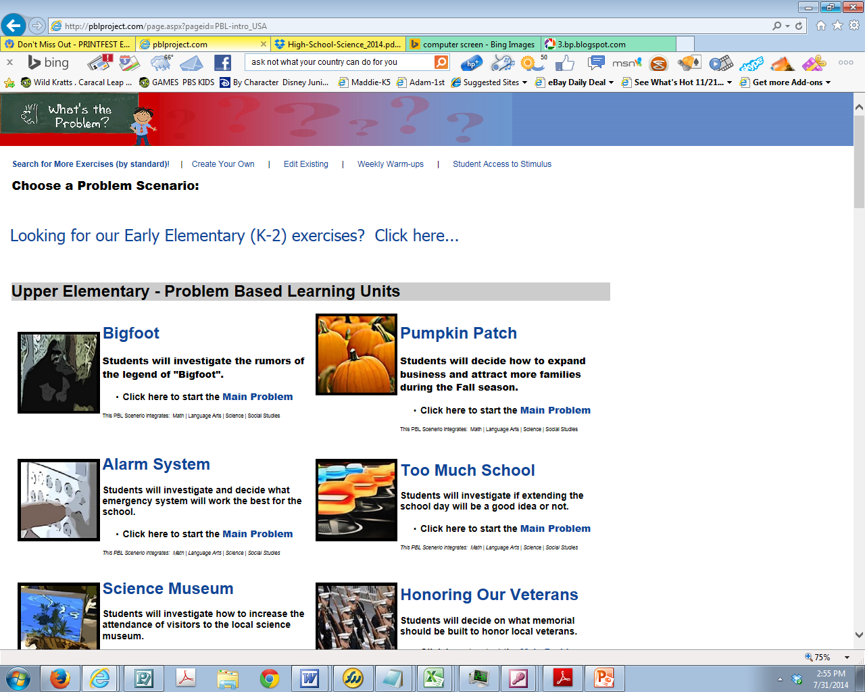
Next, click to search for exercises by standard

Slide 30
“Let the fun begin!”
You will be taken to a page where you can search and browse results.

Slide 31
One final thought:
It’s all about the process.
The purpose of these exercises is to allow students to think through problems and situations, and it’s the teacher’s role to guide them through the journey.

Slide 32
To schedule “face-to-face” Professional Development,
or for any other information,
contact:
Ben Bache
(PBL Project manager)
ben@pblproject.com
(864)-877-5123

