Slide 1
Munich Olympics (Germany) - 1972
Waldi

Slide 2
Montreal Olympics (Canada) - 1976
Amik

Slide 3
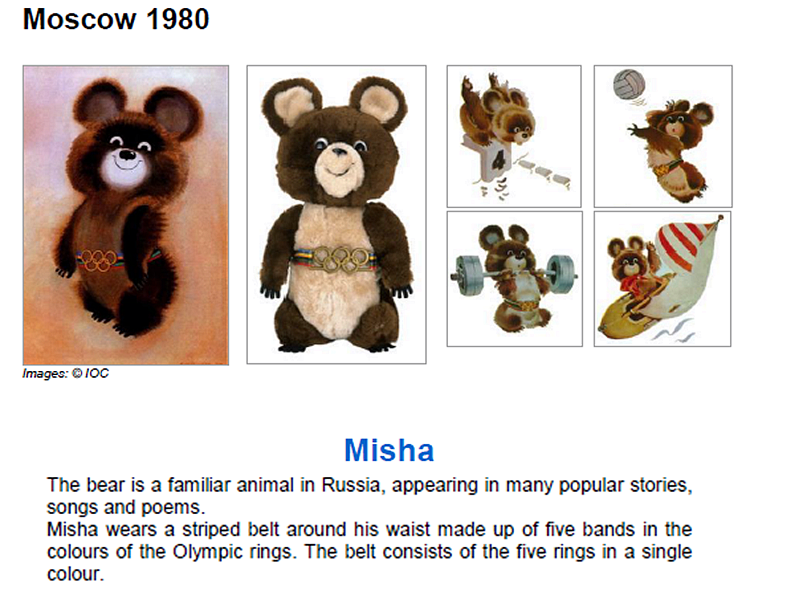
Moscow Olympics (Russia) - 1980
Misha

Slide 4
Los Angeles Olympics (USA) - 1984
Sam

Slide 5
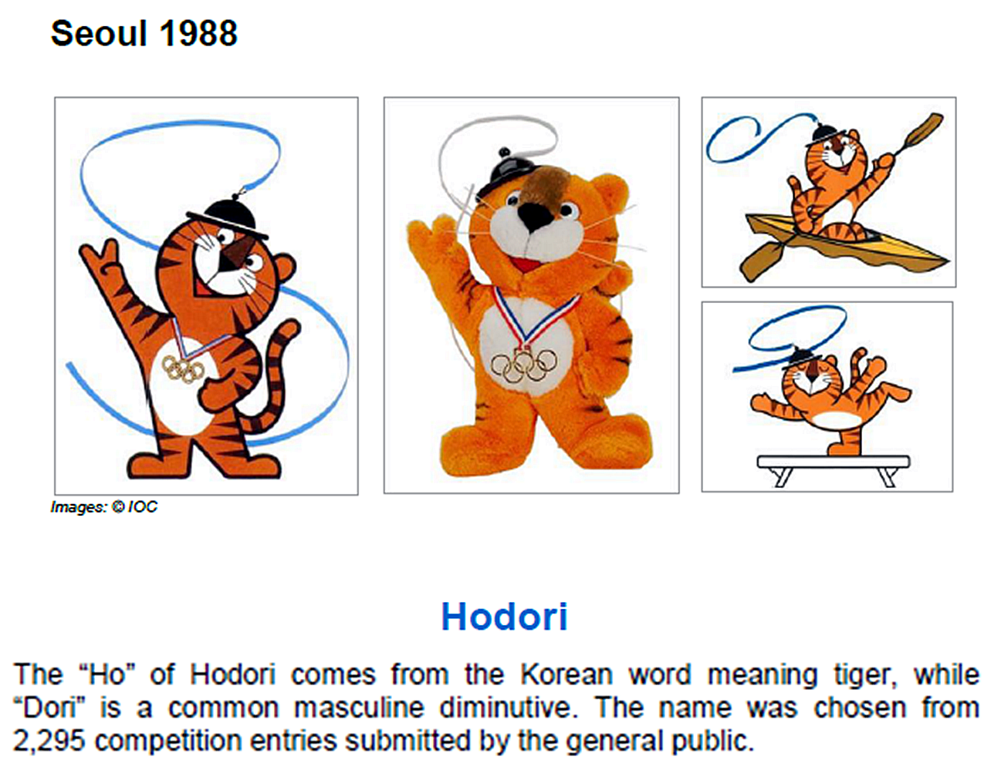
Seoul Olympics (S. Korea) - 1988
Hodori

Slide 6
Barcelona Olympics (Spain) - 1992
Cobi

Slide 7
Atlanta Olympics (USA) - 1996
Izzy

Slide 8
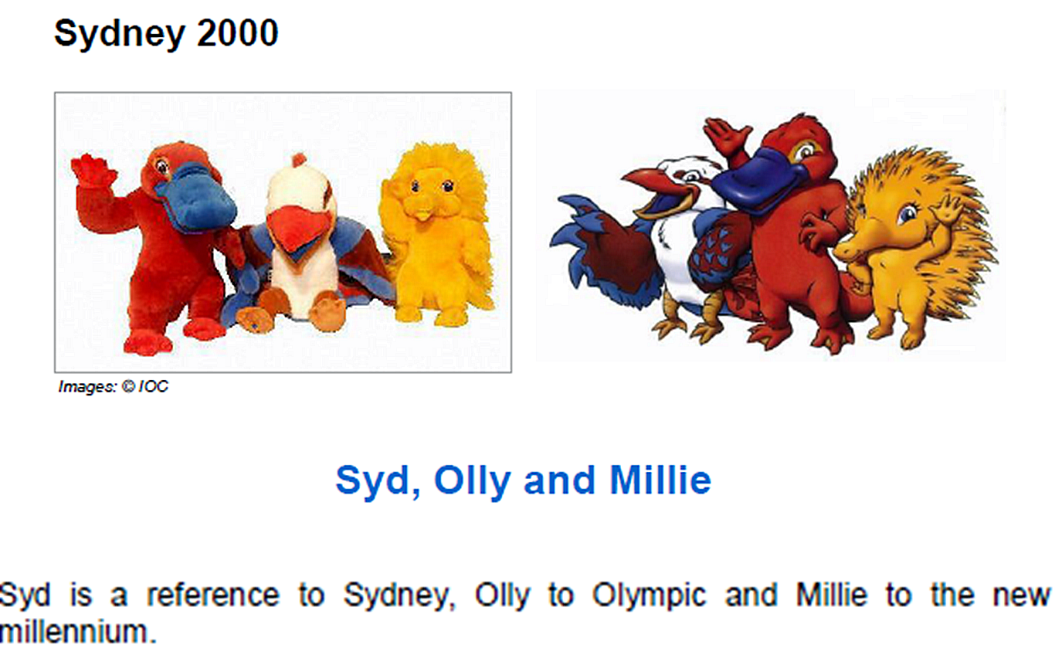
Sydney Olympics (Australia) - 2000
Syd, Olly, & Millie

Slide 9
Athens Olympics (Greece) - 2004
Phevos & Athena

Slide 10
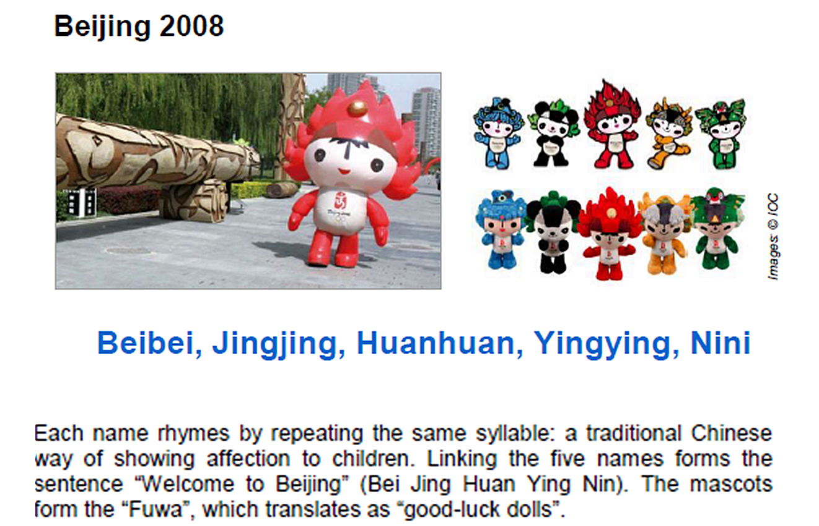
Beijing Olympics (China) - 2008
Beibei, Jingjing, Huanhuan, Yingying, Nini

Slide 11
London Olympics (England) - 2012
Wenlock

